Slide 1



Wellcome
To
Ethical Hacking class
4th Week
Day 4th
Muhammad Bilal

Slide 2
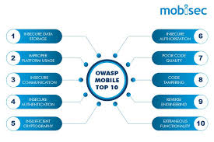
Vulnerability Analysis for Mobile Applications
Definition:
Vulnerability analysis for mobile applications involves identifying and assessing security weaknesses within mobile apps. This process aims to find flaws that could be exploited by attackers to compromise the app's functionality, steal data, or gain unauthorized access.
Examples:
1. A mobile banking app is found to store sensitive user data, such as credit card information, in plain text. This makes it easy for attackers to access this data if the device is compromised.
2. A popular social media app has an insecure API that allows attackers to retrieve user profiles without proper authentication, leading to unauthorized data exposure.

Slide 3

Vulnerability Analysis for Mobile Applications
Techniques :
Static Analysis: Reviewing the app’s code to find vulnerabilities without executing the program. Tools like MobSF (Mobile Security Framework) can help automate this process.
Dynamic Analysis: Testing the app in a runtime environment to discover issues like improper session handling or insecure data storage. Tools like Frida and Burp Suite can be used.
Tools/Websites:
OWASP Mobile Security Project: Provides guidelines and tools for securing mobile applications.
MobSF (Mobile Security Framework): An all-in-one tool for mobile app security testing.

Slide 4

Vulnerability Analysis for Network Devices
Definition:
This involves assessing network devices (like routers, switches, and firewalls)
to identify vulnerabilities that could be exploited by attackers to gain
unauthorized access, disrupt services, or intercept sensitive data.
Examples:
1. A router with an outdated firmware version contains a known vulnerability that allows attackers to execute arbitrary code remotely.
2. A network switch is found to have weak default credentials, which can be easily guessed by attackers to gain control over the device.
Techniques :
Firmware Analysis: Reviewing the firmware for known vulnerabilities or insecure configurations. Tools like Binwalk can be used for this purpose.
Configuration Review: Analyzing device settings and configurations to ensure they follow best security practices. This can be done manually or with automated tools like Nessus.

Slide 5

Vulnerability Analysis for Network Devices
Tools/Websites:
Nessus: A comprehensive vulnerability scanner that can assess network devices.
OpenVAS: Another powerful tool for vulnerability scanning in network devices.

Slide 6

Reporting and Remediation of Vulnerabilities
Definition:
This involves documenting identified vulnerabilities and providing actionable recommendations for fixing them. Reporting should be clear, precise, and include all necessary details to help developers or IT staff understand and address the vulnerabilities.
Examples:
1. After conducting a vulnerability analysis, a report is generated detailing SQL injection flaws in a web application, including proof-of-concept exploitation and steps to mitigate the risk.
2. A network vulnerability report highlights the use of weak encryption protocols on several devices, recommending an upgrade to stronger, more secure protocols.

Slide 7
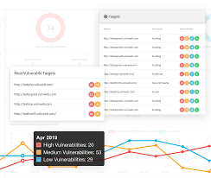
Reporting and Remediation of Vulnerabilities
Definition:
This involves documenting identified vulnerabilities and providing actionable recommendations for fixing them. Reporting should be clear, precise, and include all necessary details to help developers or IT staff understand and address the vulnerabilities.
Examples:
This involves documenting identified vulnerabilities and providing actionable recommendations for fixing them. Reporting should be clear, precise, and include all necessary details to help developers or IT staff understand and address the vulnerabilities.
A network vulnerability report highlights the use of weak encryption protocols on several devices, recommending an upgrade to stronger, more secure protocols.
Techniques:
Vulnerability Scoring: Using systems like CVSS (Common Vulnerability Scoring System) to prioritize vulnerabilities based on their severity.
Patch Management: Regularly applying patches or updates provided by vendors to fix known vulnerabilities.

Slide 8

Reporting and Remediation of Vulnerabilities
Tools/Websites:
Qualys: A cloud-based platform for vulnerability management, including reporting and remediation tracking.
Security Content Automation Protocol (SCAP): Provides a standardized approach to vulnerability management, including reporting.

Slide 9
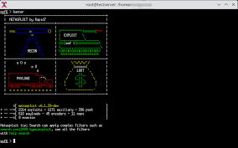
Exploitation Frameworks and Vulnerabilities
Definition:
Exploitation frameworks are tools or platforms that enable security
professionals (or attackers) to exploit vulnerabilities in systems or
applications. They provide a systematic way to launch exploits and understand the impact of vulnerabilities.
Examples:
1. Using Metasploit to exploit a known buffer overflow vulnerability in a web server, gaining remote access to the server.
2. Using the BeEF (Browser Exploitation Framework) to exploit vulnerabilities in a user's browser and gain control over the browser session.

Slide 10
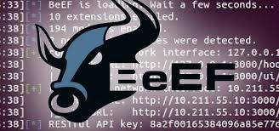
Exploitation Frameworks and Vulnerabilities
Tools/Websites:
Metasploit Framework: A widely used tool for developing and executing exploit code against a target machine.
BeEF (Browser Exploitation Framework): Focuses on exploiting vulnerabilities within web browsers.

Slide 11
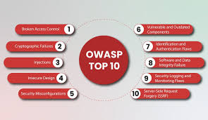
Vulnerability Analysis Best Practices
Definition:
Best practices for vulnerability analysis refer to standardized guidelines and procedures to ensure a thorough, accurate, and effective assessment of security vulnerabilities.
Examples:
1. Regularly updating vulnerability scanners and tools to ensure they recognize the latest threats and vulnerabilities.
2. Conducting both automated and manual analysis to cover all possible security weaknesses.
Techniques :
Regular Updates: Keeping tools and signatures updated to recognize the latest vulnerabilities.
Layered Analysis: Combining different analysis methods, such as static and dynamic testing, to ensure comprehensive coverage.

Slide 12
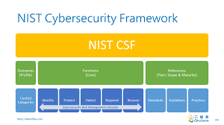
Vulnerability Analysis Best Practices
Definition:
Best practices for vulnerability analysis refer to standardized guidelines and procedures to ensure a thorough, accurate, and effective assessment of security vulnerabilities.
Examples:
1. Regularly updating vulnerability scanners and tools to ensure they recognize the latest threats and vulnerabilities.
2. Conducting both automated and manual analysis to cover all possible security weaknesses.
Techniques :
Regular Updates: Keeping tools and signatures updated to recognize the latest vulnerabilities.
Layered Analysis: Combining different analysis methods, such as static and dynamic testing, to ensure comprehensive coverage.

Slide 13

Vulnerability Analysis Best Practices
Tools/Websites:
OWASP Top Ten: A list of the most critical security
risks for web applications, which can be adapted to
other types of vulnerability analysis.
NIST Vulnerability Management: Guidelines and
best practices from the National Institute of
Standards and Technology (NIST).

Slide 14

Legal and Ethical Aspects of Vulnerability Analysis
Definition:
Legal and ethical aspects involve understanding and adhering to laws,
regulations, and moral guidelines when conducting vulnerability analysis. This ensures that the analysis is performed legally, responsibly, and with respect for privacy and data protection.
Examples:
1. Obtaining explicit consent from a company before performing a vulnerability scan on their network to avoid unauthorized access and legal consequences.
2. Ensuring that any discovered vulnerabilities are responsibly disclosed to the affected parties and not publicly exposed without giving them time to remediate.

Slide 15

Legal and Ethical Aspects of Vulnerability Analysis
Techniques:
Responsible Disclosure: Reporting vulnerabilities to the affected organization and giving them time to fix the issue before going public.
Compliance with Laws: Adhering to legal frameworks like GDPR (General Data Protection Regulation) or HIPAA (Health Insurance Portability and Accountability Act) when dealing with sensitive data.
Tools/Websites:
Bugcrowd: A platform that facilitates responsible disclosure by connecting security researchers with companies.
HackerOne: Another platform for coordinated vulnerability disclosure and ethical hacking.

Slide 16
Thank You!
Happy Hacking.

